Slide 1
ConstructPro - Basic
Presentation

Slide 2
Who we are?
Close to 100+ resource strong company
ISO 9001: 2015 certification and CMMI Level 3 certified software company
Experience level ranging from 2 years - 15 years (almost all have technical background)
Worked in almost all the major domains – Finance / Construction / Services / education / Healthcare / Manufacturing / Ecommerce
Experience in handling offshore and onsite team for domestic and international projects.

Slide 3
About ConstructPro ERP
Ennovations is into the business of developing ERP solutions specifically designed for Real Estate and Infrastructure industry.
ConstructPro ERP is a web based application built by Ennovations Techserv on dotnet framework.
It is a single window solution to automate all the business transactions, it ensures optimum utilization of resources and efficient business process management to keep in pace with the time.
Ennovations has 10+ Years Experience in construction industry, some of our esteemed clients consist of : Mittal Constructions, Gepdec Infratech Ltd and many more.

Slide 4
What is ConstructPro - Basic?
It is our pride to announce that Ennovations has come up with a new version of our ERP known as “Construct Pro -Basic” for SME Infrastructure Industries. Construct Pro -Basic is a cost effective and flexible web based ERP solution.
It is a best fit for companies implementing ERP solutions for the first time with limited no. of users. Project Portfolio Management offers Comprehensive Functionality of WBS Estimations, Planning, Scheduling, Execution Control & Review. Highly Intuitive MIS Reports and Dashboards help in driving Projects effectively. Construct Pro -Basic provides seamless integration with Tally. ( If Required ) Construct Pro -Basicis Compatible with OS: Windows, Linux, Mac and has no browser/device dependability .

Slide 5
Advance Features
Mail Conversation
Multiple Tab
Background Option
Dashboards
Multiple Language
Calculator
User Profile
AI and Machine
Learning Technology
ERP User Chat

Slide 6
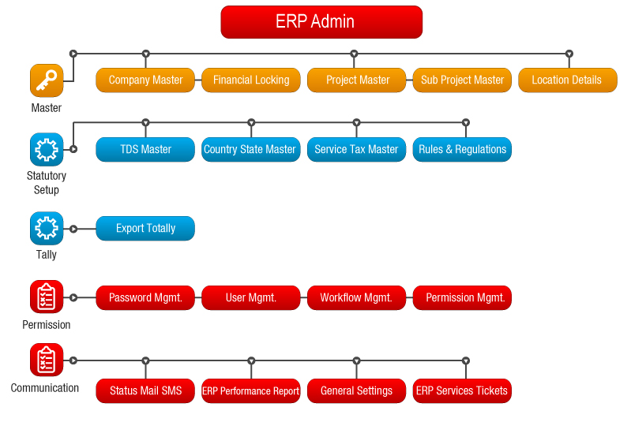
Construct Pro -Basic Basic Module Flow | ERP Admin
ERP Admin
Insert the Sub Title
of Your Presentation

Slide 7
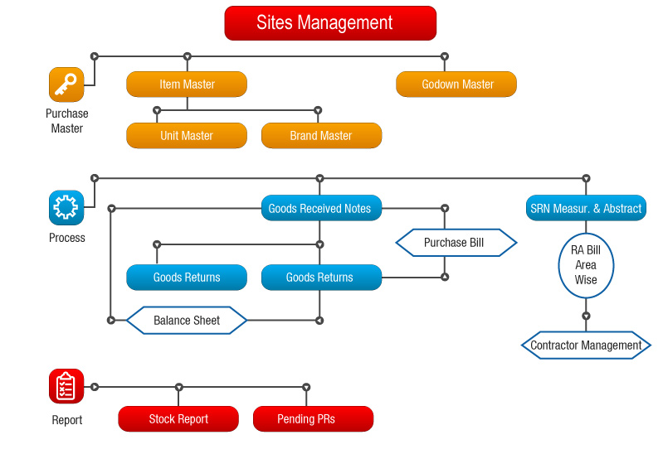
Construct Pro -Basic Module Flow | Sites Management
Sites Management
Can Manage
SRN – Measurement and
Abstract,
Purchase Requisition,
Goods Received Notes,
Insert the Sub Title
of Your Presentation

Slide 8
Reports | Sites Management
MIS Reports
Dashboard Reports
Stock Ledger
Stock Report
Pending PRs
Pending Pos for GRN
Goods Received Register
Store Aging Report
Stock in Hand
Stock Aging Report

Slide 9
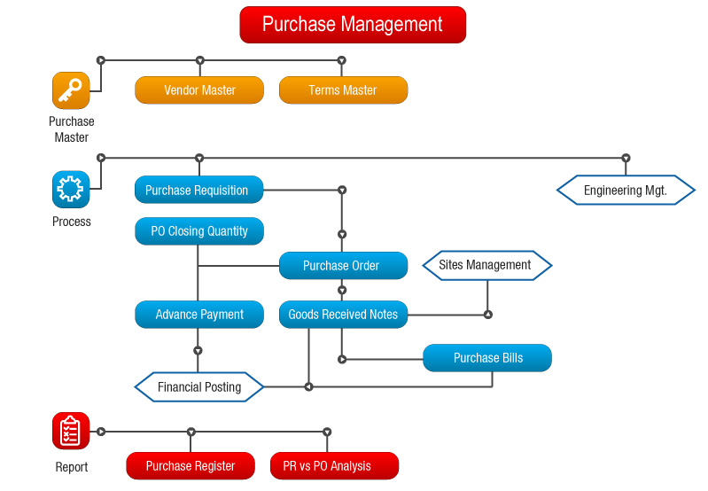
Construct Pro -Basic Module Flow | Purchase Management
Purchase
Management
Can Manage
Purchase Requisition,
Pending Requisition,
Comparative Statement,
Shortlist Vendor,
Purchase Order ,
Advance Payment,
P.O Closing Quantity
Vendor Evaluation.
Insert the Sub Title
of Your Presentation

Slide 10
Report | Purchase Management
MIS Reports
Dashboard Reports
Supplier Ledger
Indent Register
PO Register
PO vs GRN Analysis
PR vs PO vs GRN vs PB Analysis
GRN vs. Purchase Bill Analysis
Purchase Bills
Purchase Orders vs. Purchase Bills

Slide 11
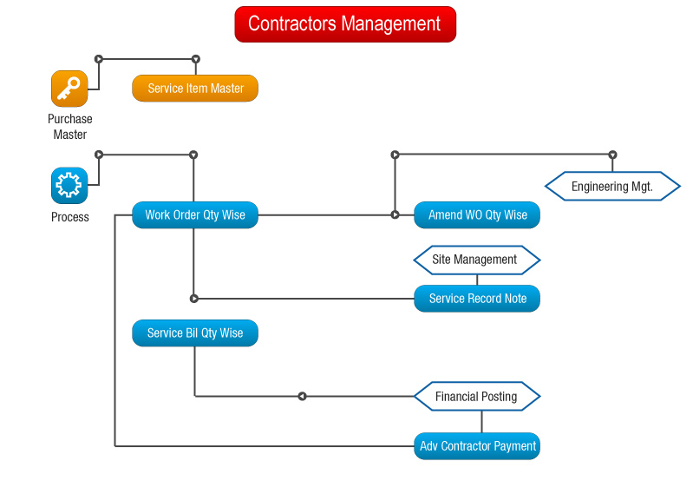
Construct Pro -Basic Module Flow | Contractors Management
Contractors
Management
Can Manage
Requisition for Services,
Tender Registration,
Comparison Perc and
Qty Wise,
Work Order Perc and
Qty Wise,
Amend WO Qty Wise,
Service Bill Perc and
Qty Wise,
Insert the Sub Title
of Your Presentation

Slide 12
Reports | Contractors Management
MIS Reports
Dashboard Reports
Contractor Advance Summary
Project Wise WO vs. Work Done
Month Wise Work Order

Slide 13
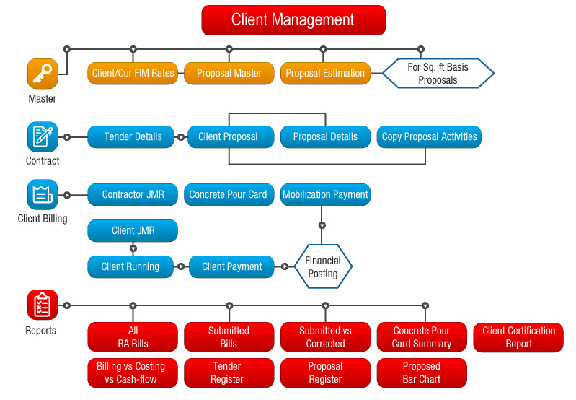
Construct Pro -BasicModule Flow | Clients Management
Clients
Management
Can Manage ,
Proposal Estimation,
Tender Note Detail,
Client Proposal,
Client Billing
Etc.
Insert the Sub Title
of Your Presentation

Slide 14
Reports | Clients Management
MIS Reports
Proposed Bar Chart
All RA Bills
Inward Cash flow
Etc.

Slide 15
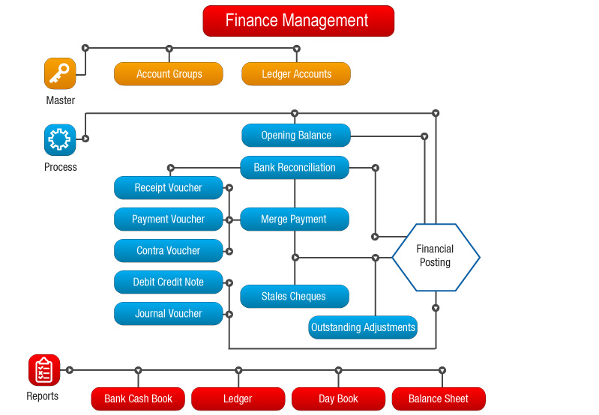
Construct Pro -Basic Module Flow | Finance Management
Finance Management
Can Manage
Ledger Accounts,
Group Ledger ,
Trial Balance ,
Profit and Loss account,
Balance sheet and
Day Book .
Insert the Sub Title
of Your Presentation

Slide 16
Report | Finance Management
MIS Reports
Dashboard Reports
Bank Reconciliation Report
Ledger Confirmation
Balance Sheet
Joint Trial Balance Report
Profit Loss Analysis
Outstanding Payable
Project Wise
Outstanding Payable
Funds Availability

Slide 17
Construct Pro -Basic – Add-ons’s Module
Email Configuration
Statutory Management
SMS Configuration
Tally Integration
MSP Import & Export
Mobile ERP App

Slide 18
Customer Base
300+
customers
Across
PAN India
Mumbai
Bangalore
Pune
Ahmedabad
Delhi
Serving
Verticals
Real Estate
Infrastructure
Manufacturing

Slide 19
Contact Us
INDIA - CORPORATE OFFICE
Ennovations Techserv Pvt. Ltd.,
2nd floor, D1, Sector 7,
Noida - 201301,
Uttar Pradesh, INDIA.
+91 9811410979, +91 9871791597
infoindia@ennomail.com

